Slide 1
cryptocurrency
Volatility As a Function Of Market Dynamics

Slide 2
What is a Cryptocurrency?
Cryptocurrencies are cryptographically created digital tokens that can be used as a medium of exchange and a store of value without the need of physical tender.

Slide 3
cryptocurrency
Volatility As a Function Of Market Dynamics

Slide 4
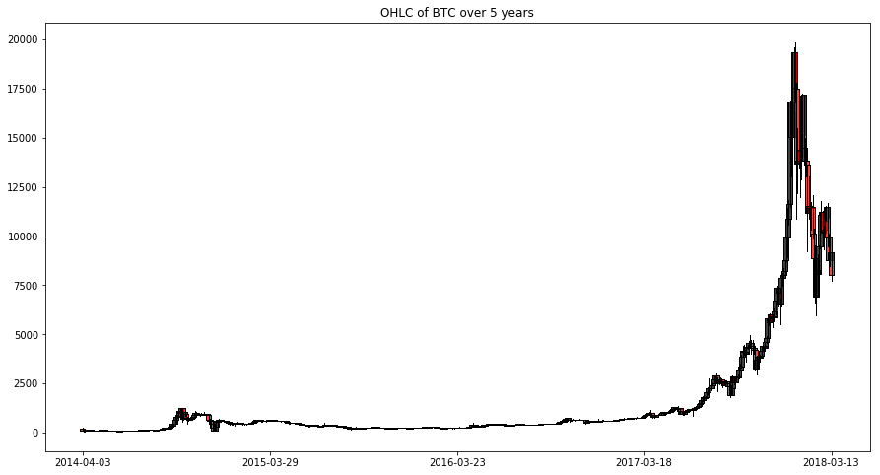
Price analysis of Bitcoin over 5 years. We selected Bitcoin as they are the crypto market leader.

Slide 5
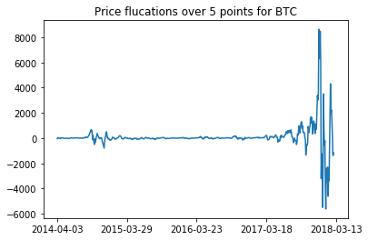
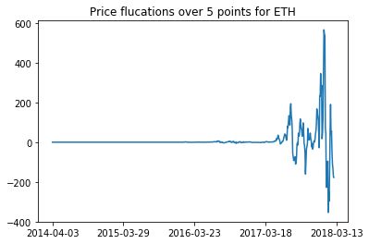
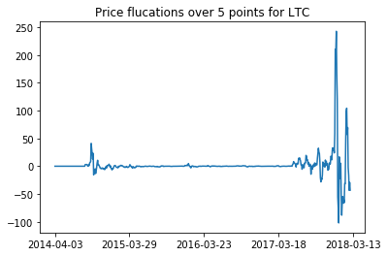
Price change (velocity) analysis

Slide 6
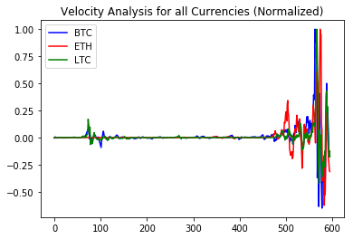
Normalized price changes

Slide 7
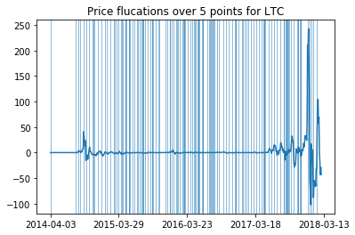
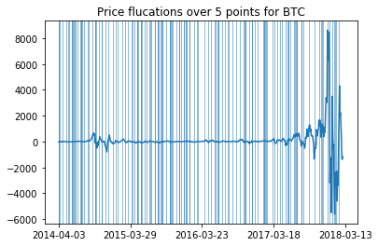
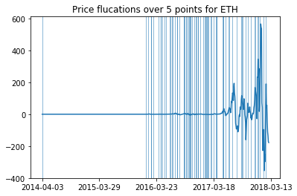
Velocity analysis identifying peaks

Slide 8
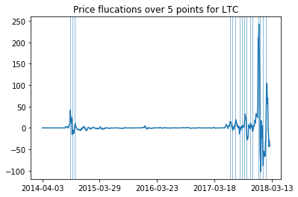
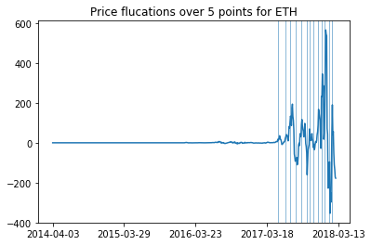
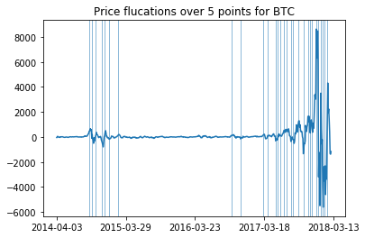
Identifying peaks (filtered)

Slide 9
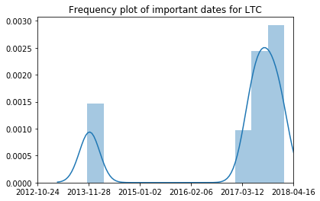
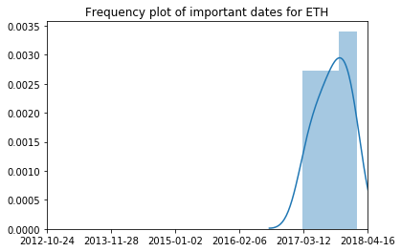
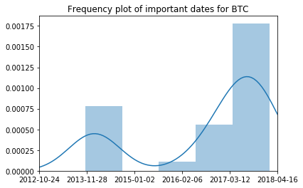
Important dates
Important Dates for BTC:
2013-11-13
2013-11-28
2013-12-25
2014-02-02
2014-02-20
2014-03-19
2014-05-18
2016-05-28
2016-07-24
2016-12-15
2017-01-17
2017-03-09
2017-03-24
2017-04-05
2017-05-02
2017-05-17
2017-06-16
2017-06-28
2017-08-03
2017-09-05
2017-10-05
2017-10-20
2017-11-01
2017-11-28
2017-12-13
2017-12-25
2018-01-09
2018-01-21
2018-02-08
Important Dates for ETH:
2017-03-06
2017-04-20
2017-05-23
2017-06-25
2017-07-31
2017-09-02
2017-09-20
2017-10-14
2017-11-13
2017-12-04
2017-12-25
2018-01-21
2018-02-08
Important Dates for LTC
2013-11-19
2013-12-04
2013-12-25
2017-04-26
2017-05-17
2017-06-07
2017-07-10
2017-07-31
2017-08-18
2017-09-05
2017-10-05
2017-10-20
2017-12-04
2017-12-19
2018-01-12
2018-02-05

Slide 10
4 year stock history of apple and microsoft

Slide 11
Acceleration analysis of apple and Microsoft stock history

Slide 12
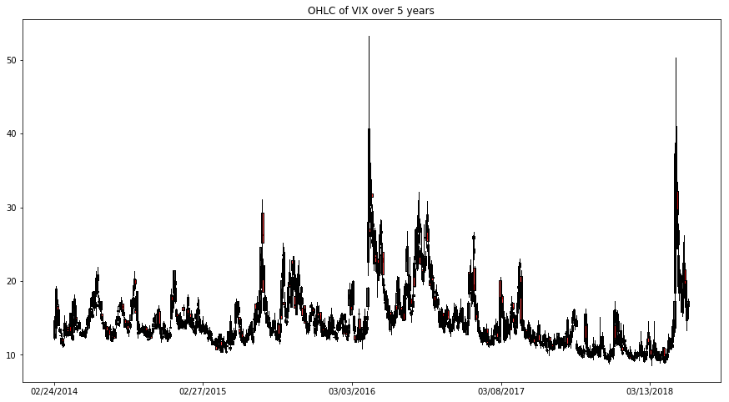

Slide 13
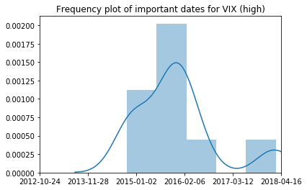
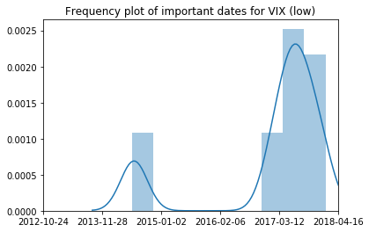
Important date frequency analysis for volatility index

